Slide 1
Embedded hardware for Linux systems

Slide 2
Processor and architecture (1)
The Linux kernel and most other architecture-dependent components support a wide range of 32 and 64 bit architectures
x86 and x86-64, as found on PC platforms, but also embedded systems (multimedia, industrial)
ARM, with hundreds of different System on Chips (SoC: CPU + on-chip devices, for all sorts of products)
RISC-V, the rising architecture with a free instruction set
(from high-end cloud computing to the smallest embedded systems)
PowerPC (mainly real-time, industrial applications)
MIPS (mainly networking applications)
Microblaze (Xilinx), Nios II (Altera): soft cores on FPGAs
Others: ARC, m68k, Xtensa, SuperH...

Slide 3
Processor and architecture (2)
Both MMU and no-MMU architectures are supported, even though no-MMU architectures have a few limitations.
Linux does not support small microcontrollers (8 or 16 bit)
Besides the toolchain, the bootloader and the kernel, all other components are generally architecture-independent

Slide 4
RAM and storage
RAM: a very basic Linux system can work within 8 MB of RAM, but a more realistic system will usually require at least 32 MB of RAM. Depends on the type and size of applications.
Storage: a very basic Linux system can work within 4 MB of storage, but usually more is needed.
Block storage: SD/MMC/eMMC, USB mass storage, SATA, etc,
Raw flash storage is supported too, both NAND and NOR flash, with specific filesystems
Not necessarily interesting to be too restrictive on the amount of RAM/storage: having flexibility at this level allows to re-use as many existing components as possible.

Slide 5
Communication
The Linux kernel has support for many common communication buses
I2C
SPI
1-wire
SDIO
PCI
USB
CAN (mainly used in automotive)
And also extensive networking support
Ethernet, Wifi, Bluetooth, CAN, etc.
IPv4, IPv6, TCP, UDP, SCTP, DCCP, etc.
Firewalling, advanced routing, multicast

Slide 6
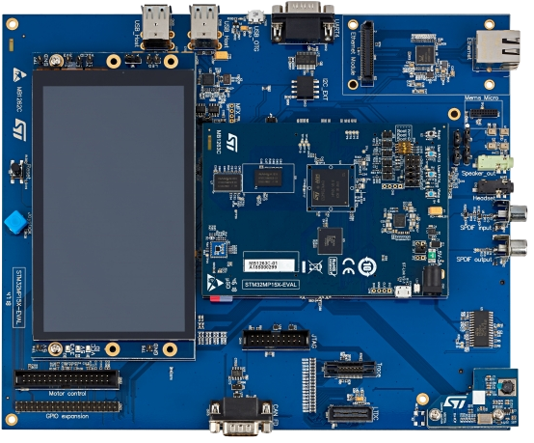
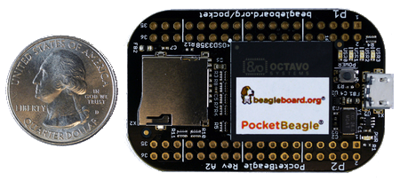
Types of hardware platforms (1)
Evaluation platforms from the SoC vendor. Usually expensive, but many peripherals are built-in. Generally unsuitable for real products, but best for product development.
Component on Module, a small board with only CPU/RAM/flash and a few other core components, with connectors to access all other peripherals. Can be used to build end products for small to medium quantities.
STM32MP157C-EV1
evaluation board
Image credits (st.com):
https://frama.link/NySnaxuV
PocketBeagle
Image credits (Beagleboard.org):
https://beagleboard.org/pocket

Slide 7
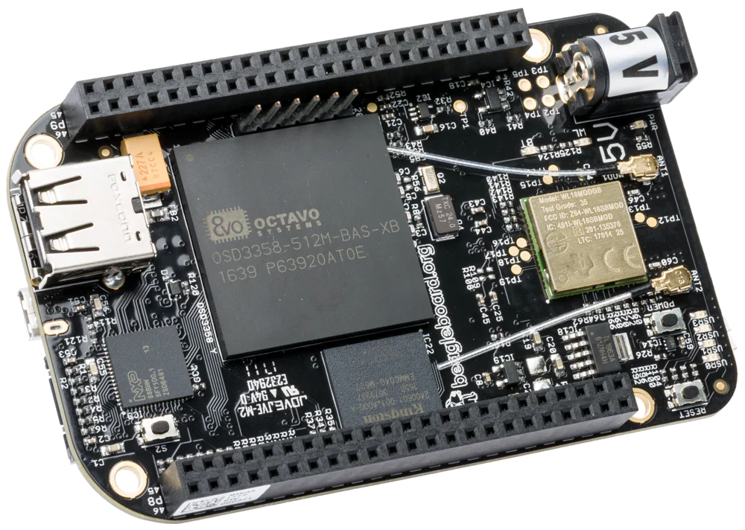
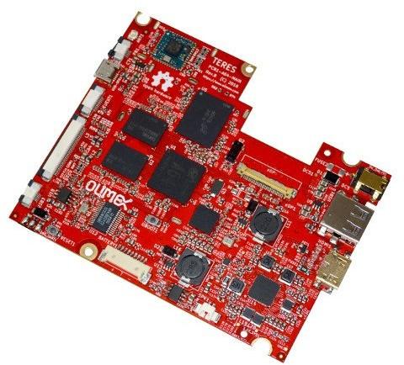
Types of hardware platforms (2)
Community development platforms, to make a particular SoC popular and easily available. These are ready-to-use and low cost, but usually have fewer peripherals than evaluation platforms. To some extent, can also be used for real products.
Custom platform. Schematics for evaluation boards or development platforms are more and more commonly freely available, making it easier to develop custom platforms.
Beaglebone Black Wireless board
Olimex Open hardware ARM laptop main board
Image credits (Olimex):
https://www.olimex.com/Products/
DIY-Laptop/

Slide 8
Criteria for choosing the hardware
Make sure the SoC you plan to use is already supported by the Linux kernel, and has an open-source bootloader.
Having support in the official versions of the projects (kernel, bootloader) is a lot better: quality is better, new versions are available, and Long Term Support releases are available.
Some SoC vendors and/or board vendors do not contribute their changes back to the mainline Linux kernel. Ask them to do so, or use another product if you can. A good measurement is to see the delta between their kernel and the official one.
Between properly supported hardware in the official Linux kernel and poorly-supported hardware, there will be huge differences in development time and cost.

Slide 9
Embedded Linux system architecture

Slide 10
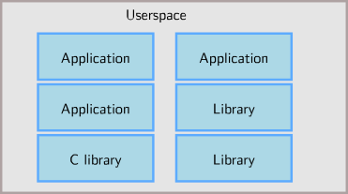
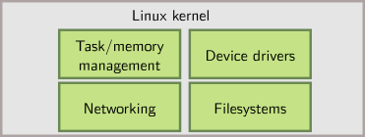
Host and target

Slide 11
Software components
Cross-compilation toolchain
Compiler that runs on the development machine, but generates code for the target
Bootloader
Started by the hardware, responsible for basic initialization, loading and executing the kernel
Linux Kernel
Contains the process and memory management, network stack, device drivers and provides services to user space applications
C library
Of course, a library of C functions
Also the interface between the kernel and the user space applications
Libraries and applications
Third-party or in-house

Slide 12
Embedded Linux work
Several distinct tasks are needed when deploying embedded Linux in a product:
Board Support Package development
A BSP contains a bootloader and kernel with the suitable device drivers for the targeted hardware
Purpose of our Kernel Development course
System integration
Integrate all the components, bootloader, kernel, third-party libraries and applications and in-house applications into a working system
Purpose of this course
Development of applications
Normal Linux applications, but using specifically chosen libraries

Slide 13
Embedded Linux development environment
These slides are taken from www.bootlin.com

Slide 14
Embedded Linux solutions
Two ways to switch to embedded Linux
Use solutions provided and supported by vendors like MontaVista, Wind River or TimeSys. These solutions come with their own development tools and environment. They use a mix of open-source components and proprietary tools.
Use community solutions. They are completely open, supported by the community.
In Bootlin training sessions, we do not promote a particular vendor, and therefore use community solutions
However, knowing the concepts, switching to vendor solutions will be easy

Slide 15




















OS for Linux development
We strongly recommend to use GNU/Linux as the desktop operating system to embedded Linux developers, for multiple reasons.
All community tools are developed and designed to run on Linux. Trying to use them on other operating systems (Windows, Mac OS X) will lead to trouble.
As Linux also runs on the embedded device, all the knowledge gained from using Linux on the desktop will apply similarly to the embedded device.
If you are stuck with a Windows desktop, at least you should use GNU/Linux in a virtual machine (such as VirtualBox which is open source), though there could be a small performance penalty. With Windows 10, you can also run your favorite native Linux distro through Windows Subsystem for Linux (WSL2)
:-)

Slide 16



Desktop Linux distribution
Any good and sufficiently recent Linux desktop distribution can be used for the development workstation
Ubuntu, Debian, Fedora, openSUSE, Red Hat, etc.
We have chosen Ubuntu, as it is a widely used and easy to use desktop Linux distribution
The Ubuntu setup on the training laptops has intentionally been left untouched after the normal installation process. Learning embedded Linux is also about learning the tools needed on the development workstation!
Image credits:
https://tinyurl.com/f4zxj5kw

Slide 17
Linux root and non-root users
Linux is a multi-user operating system
The root user is the administrator, and it can do privileged operations such as: mounting filesystems, configuring the network, creating device files, changing the system configuration, installing or removing software
All other users are unprivileged, and cannot perform these administrator-level operations
On an Ubuntu system, it is not possible to log in as root, only as a normal user.
The system has been configured so that the user account created first is allowed to run privileged operations through a program called sudo.
Example: sudo mount /dev/sda2 /mnt/disk

Slide 18
Software packages
The distribution mechanism for software in GNU/Linux is different from the one in Windows
Linux distributions provides a central and coherent way of installing, updating and removing applications and libraries: packages
Packages contains the application or library files, and associated meta-information, such as the version and the dependencies
.deb on Debian and Ubuntu, .rpm on Red Hat, Fedora, openSUSE
Packages are stored in repositories, usually on HTTP or HTTPS servers
You should only use packages from official repositories for your distribution, unless strictly required.
Note: Snap and Flatpak offer new ways of packaging applications in a self-contained way. See https://www.atechtown.com/flatpak-vs-snap/.

Slide 19
Managing software packages (1)
Instructions for Debian based GNU/Linux systems (Debian, Ubuntu...)
Package repositories are specified in /etc/apt/sources.list and in files under
/etc/apt/sources.list.d/
To update package repository lists:
sudo apt update
To find the name of a package to install, the best is to use the search engine on https://packages.debian.org or on https://packages.ubuntu.com. You may also use:
apt-cache search <keyword>

Slide 20
Managing software packages (2)
To install a given package:
sudo apt install <package>
To remove a given package:
sudo apt remove <package>
To install all available package updates:
sudo apt dist-upgrade
Get information about a package:
apt show <package>
Graphical interfaces
Synaptic for GNOME
KPackageKit for KDE
Further details on package management:
https://www.debian.org/doc/manuals/debian-reference/ch02.en.html

Slide 21
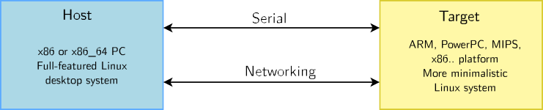
Host vs. target
When doing embedded development, there is always a split between
The host, the development workstation, which is typically a powerful PC
The target, which is the embedded system under development
They are connected by various means: almost always a serial line for debugging purposes, frequently a networking connection, sometimes a JTAG interface for low-level debugging

Slide 22
Serial line communication program
An essential tool for embedded development is a serial line communication program, like HyperTerminal in Windows.
There are multiple options available in Linux: Minicom, Picocom, Gtkterm, Putty, screen and the new tio (https://github.com/tio/tio).
In this training session, we recommend using the simplest of them: Picocom
Installation with sudo apt install picocom
Run with picocom -b BAUD_RATE /dev/SERIAL_DEVICE.
Exit with [Ctrl][a] [Ctrl][x]
SERIAL_DEVICE is typically
ttyUSBx for USB to serial converters
ttySx for real serial ports
Most frequent command: picocom -b 115200 /dev/ttyUSB0

Slide 23
Command line tips
Using the command line is mandatory for many operations needed for embedded Linux development
It is a very powerful way of interacting with the system, with which you can save a lot of time.
Some useful tips
You can use several tabs in the Gnome Terminal
Remember that you can use relative paths (for example: ../../linux) in addition to absolute paths (for example: /home/user)
In a shell, hit [Control] [r], then a keyword, will search through the command
history. Hit [Control] [r] again to search backwards in the history
You can directly copy/paste paths from the file manager to Gnome Terminal by drag-and-drop.

